Slide 1
ECON 3510 International Trade Theory and Policy
The Standard Trade Model
Tutorial 6
Notes:
If this PowerPoint presentation contains mathematical equations, you may need to check that your computer has the following installed:
1) MathType Plugin
2) Math Player (free versions available)
3) NVDA Reader (free versions available)

Slide 2
Recap of Lecture 6
Export-biased growth reduces a country’s terms of trade and welfare
Import-biased growth increases a country’s terms of trade and welfare
International borrowing and lending as intertemporal trade
Labor migration and wage equalization

Slide 3
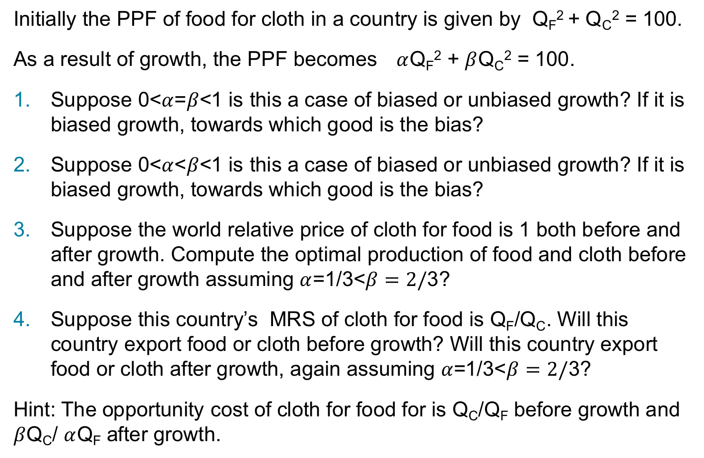
Exercise 1
Initially the PPF of food for cloth in a country is given by Q_{F}² + Q_{C}² = 100.
As a result of growth, the PPF becomes $α$Q_{F}² + $β$Q_{C}² = 100.
Suppose 0<$α$=$β$<1 is this a case of biased or unbiased growth? If it is biased growth, towards which good is the bias?
Suppose 0<$α$<$β$<1 is this a case of biased or unbiased growth? If it is biased growth, towards which good is the bias?
Suppose the world relative price of cloth for food is 1 both before and after growth. Compute the optimal production of food and cloth before and after growth assuming $α$=1/3<$β=2/$3?
Suppose this country’s MRS of cloth for food is Q_{F}/Q_{C}. Will this country export food or cloth before growth? Will this country export food or cloth after growth, again assuming $α$=1/3<$β=2/$3?
Hint: The opportunity cost of cloth for food for is Q_{C}/Q_{F} before growth and $β$Q_{C}/ $α$Q_{F} after growth.

Slide 4
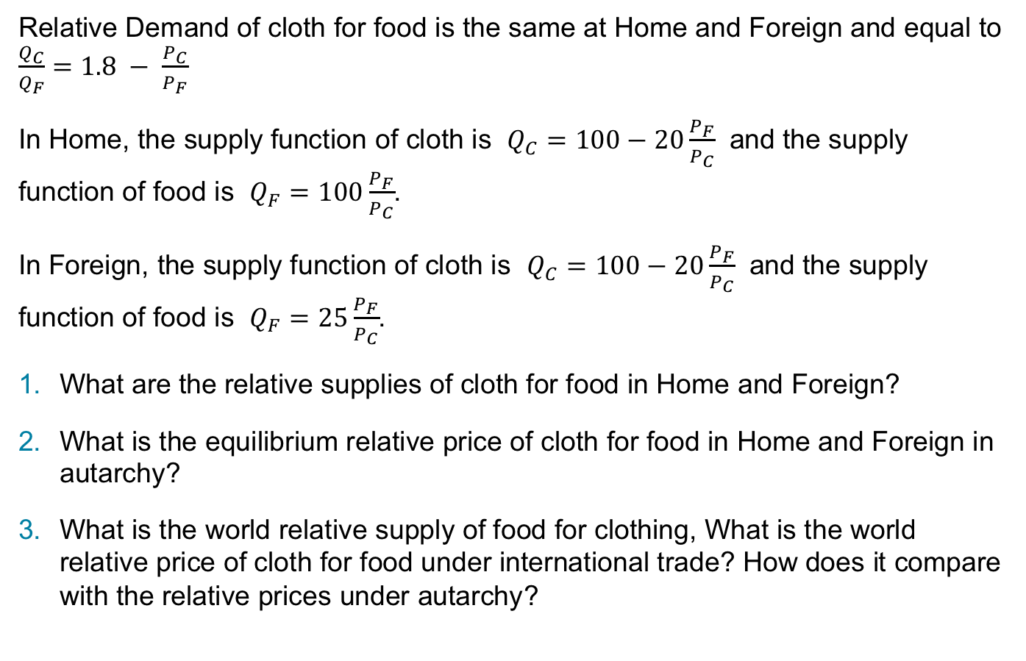
Exercise 2
Relative Demand of cloth for food is the same at Home and Foreign and equal to $\frac{Q_{C}}{Q_{F}}=1.8 − \frac{P_{C}}{P_{F}}$
In Home, the supply function of cloth is $Q_{C}=100−20\frac{P_{F}}{P_{C}}$ and the supply function of food is $Q_{F}=100\frac{P_{F}}{P_{C}}$.
In Foreign, the supply function of cloth is $Q_{C}=100−20\frac{P_{F}}{P_{C}}$ and the supply function of food is $Q_{F}=25\frac{P_{F}}{P_{C}}$.
What are the relative supplies of cloth for food in Home and Foreign?
What is the equilibrium relative price of cloth for food in Home and Foreign in autarchy?
What is the world relative supply of food for clothing, What is the world relative price of cloth for food under international trade? How does it compare with the relative prices under autarchy?

Slide 5
Exercise 3
The lecture argues that recent immigration in the USA has been mostly by workers with the lowest education levels, possibly:
reducing wages for native-born workers with low education levels
helping widening the wage gap between less educated workers and highly educated workers
What about Australia?
https://www.aph.gov.au/About_Parliament/Parliamentary_Departments/Parliamentary_Library/pubs/BriefingBook45p/MigrationFlows
https://crawford.anu.edu.au/files/uploads/crawford01_cap_anu_edu_au/2018-05/policy_note_-_immigration.pdf
https://www.rba.gov.au/publications/confs/2019/pdf/christian-dustmann.pdf

